Slide 1

Lecture 3
Matrix Algebra

Slide 2

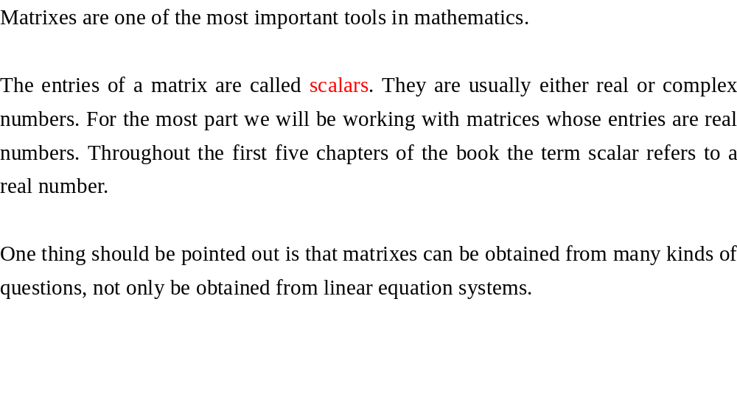
Notes:
The relation of a net. A schedule of some airplane company.

Slide 3
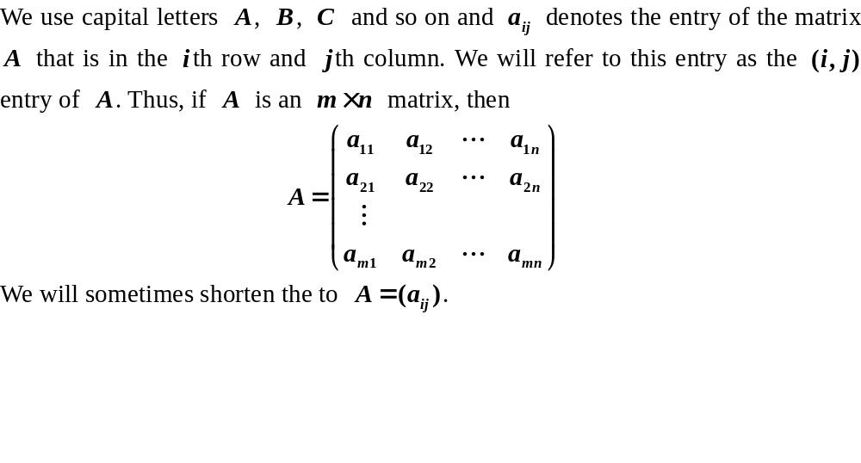
Matrix Notation

Slide 4
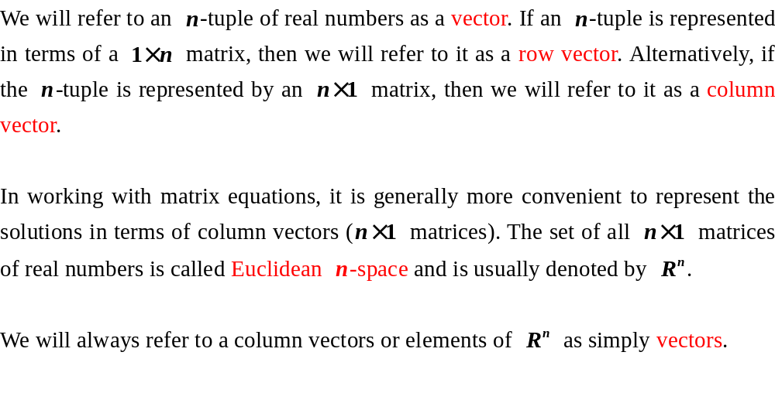
Vectors

Slide 5
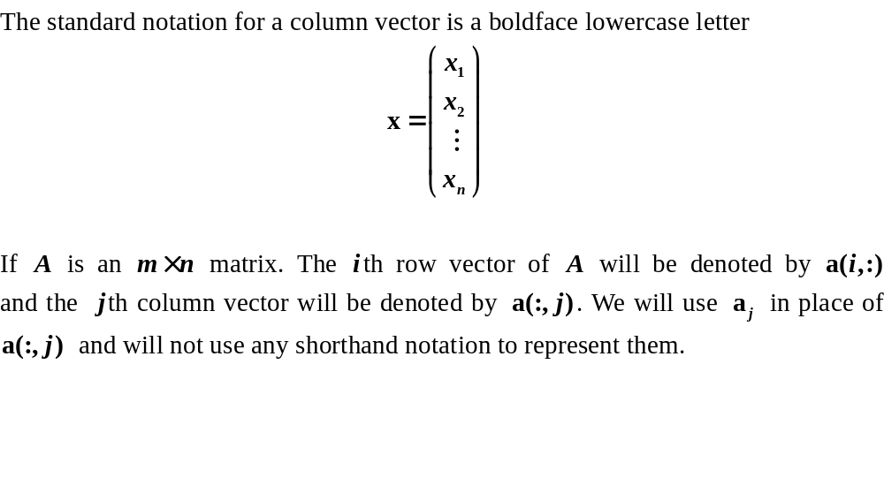
Vectors

Slide 6
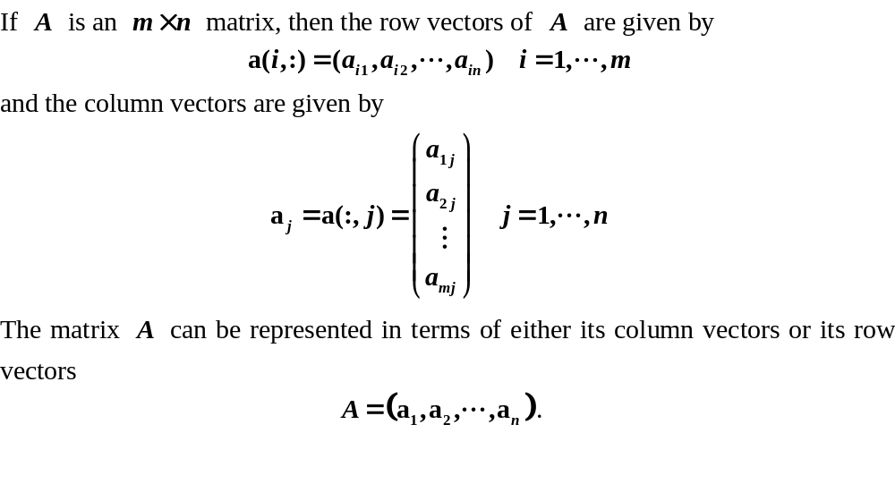
Vectors

Slide 7
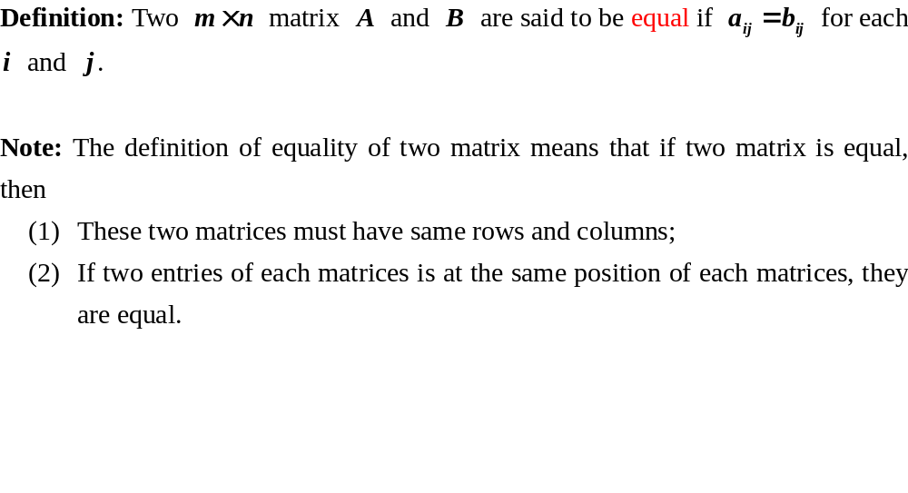
Equality

Slide 8
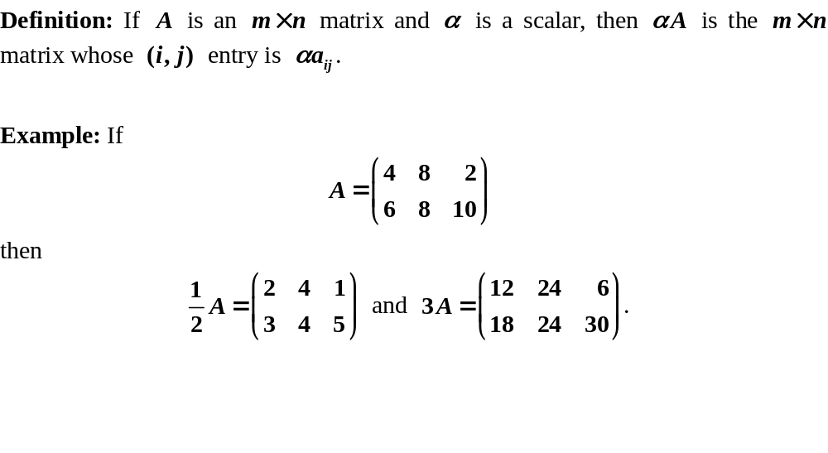
Scalar multiplication

Slide 9
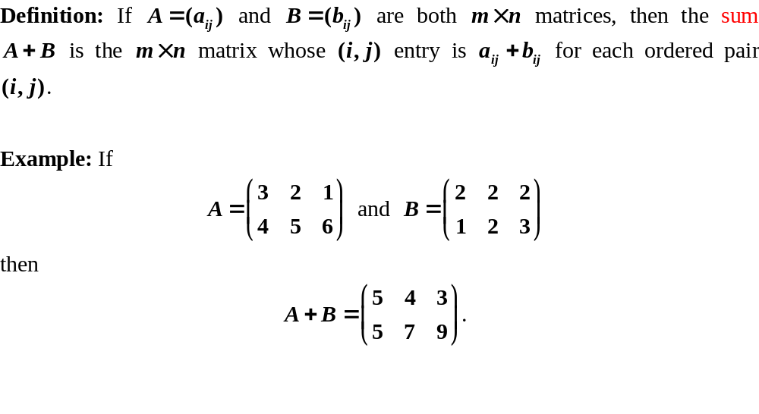
Matrix addition

Slide 10
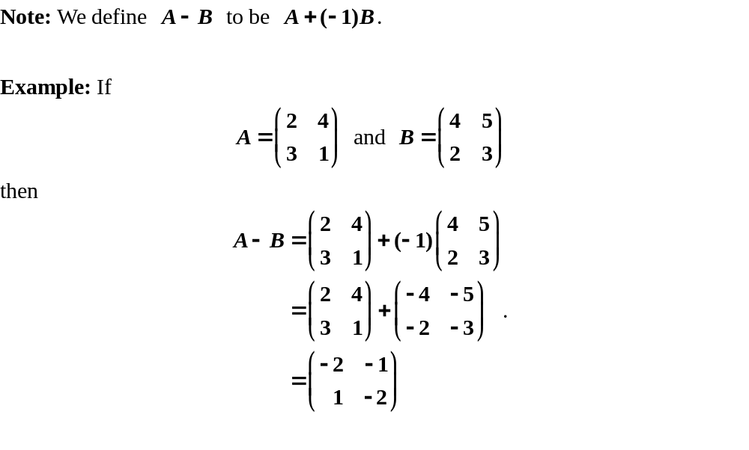
Matrix addition

Slide 11
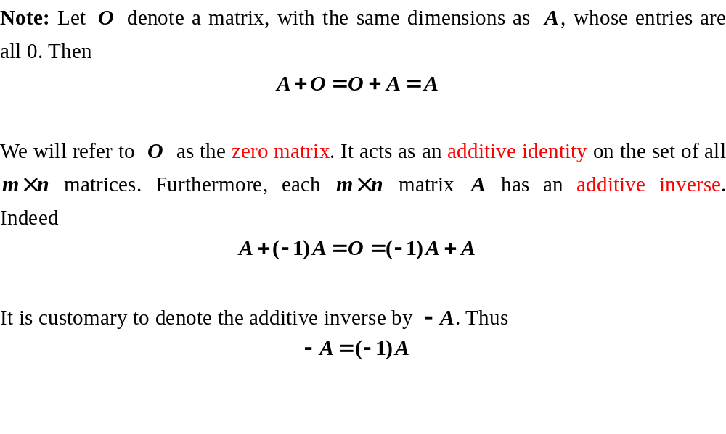
Matrix addition

Slide 12
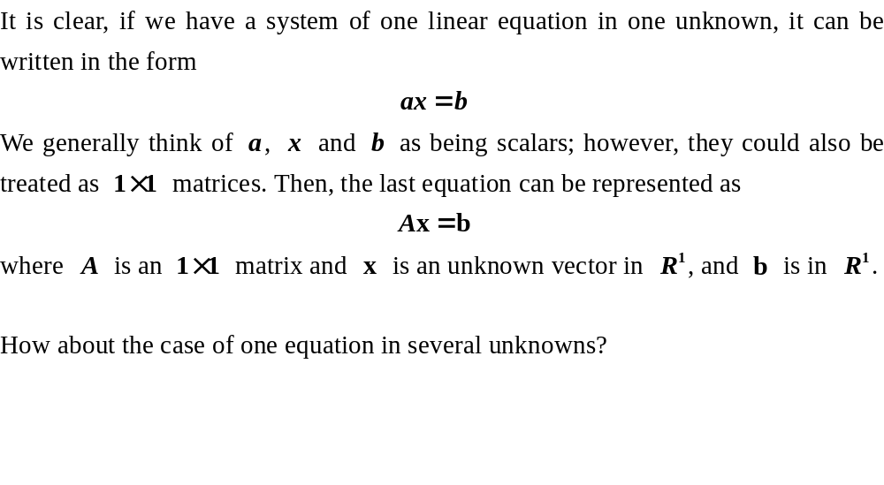
Matrix multiplication and linear systems

Slide 13
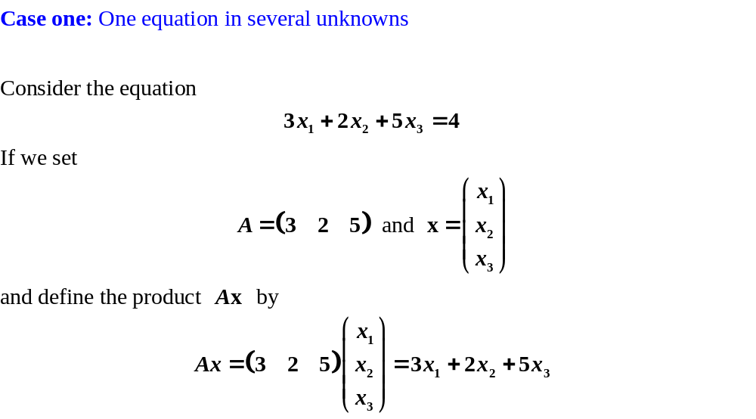
Matrix multiplication and linear systems

Slide 14
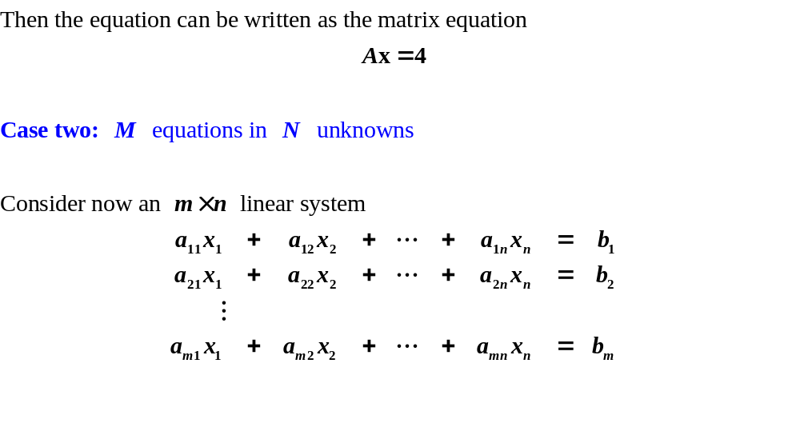
Matrix multiplication and linear systems

Slide 15
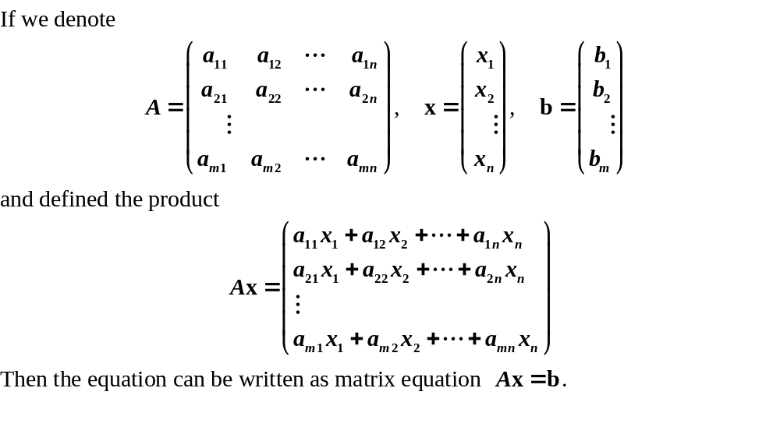
Matrix multiplication and linear systems

Slide 16
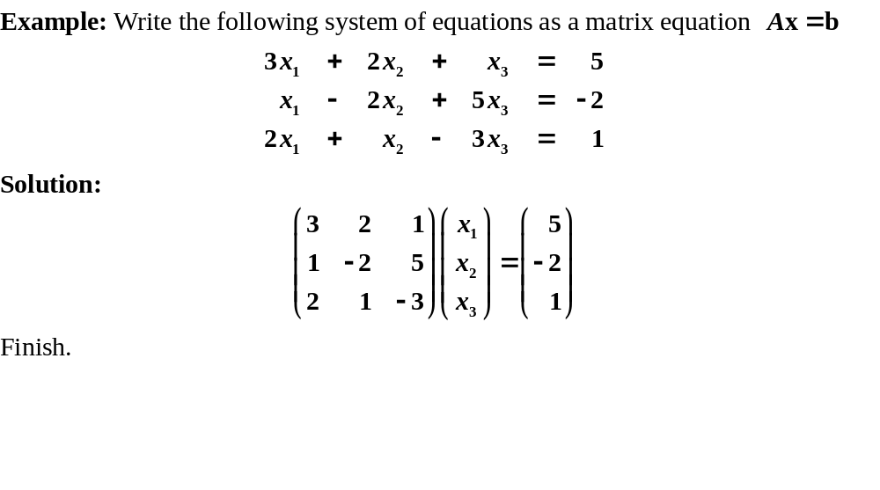
Matrix multiplication and linear systems

Slide 17
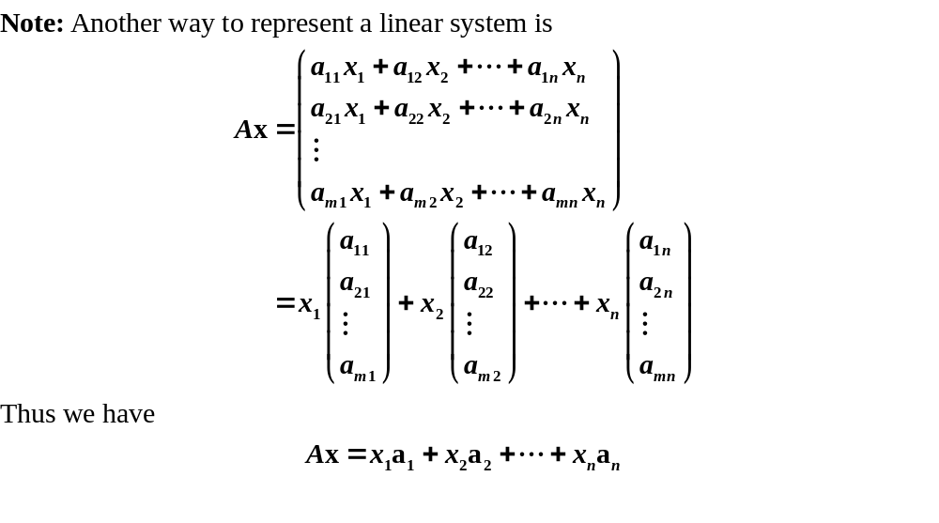
Matrix multiplication and linear systems

Slide 18
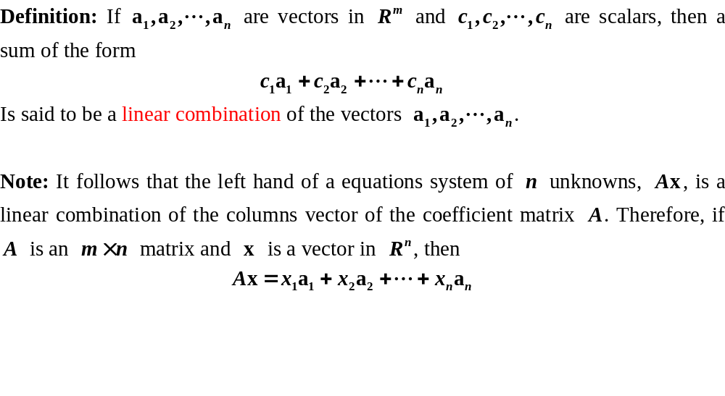
Matrix multiplication and linear systems

Slide 19
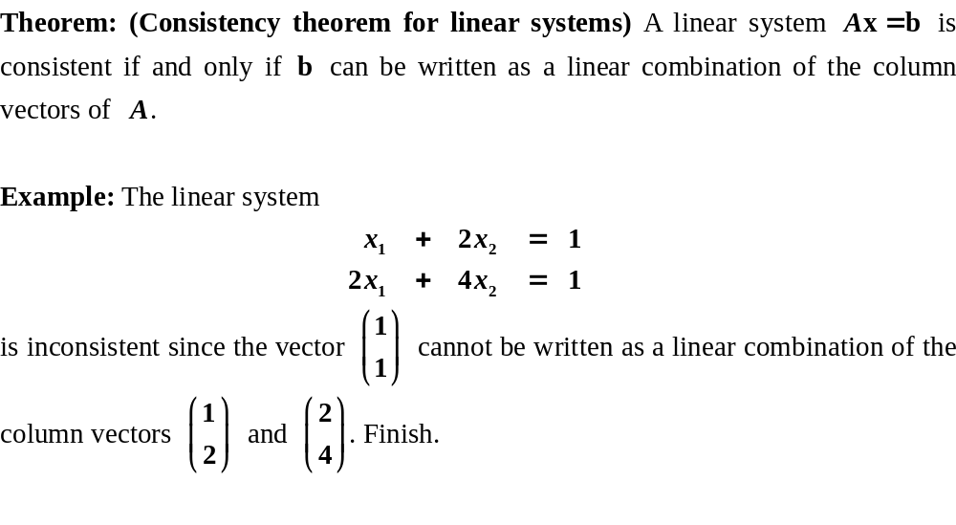
Matrix multiplication and linear systems

Slide 20
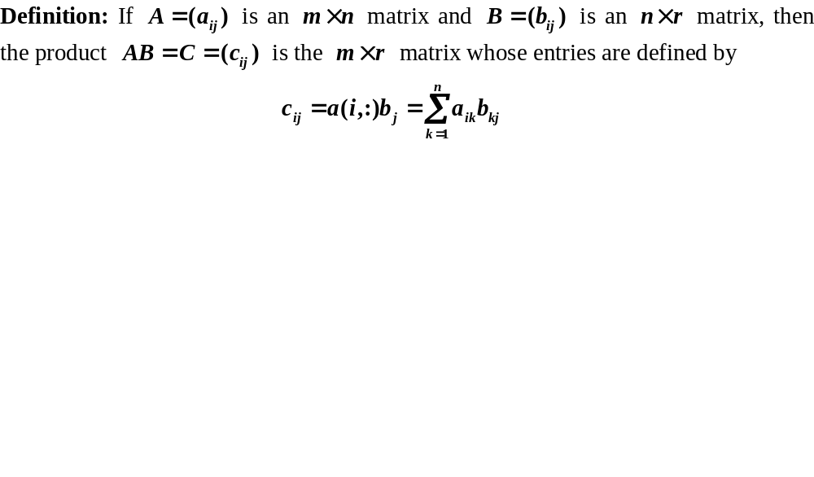
Matrix multiplication

Slide 21
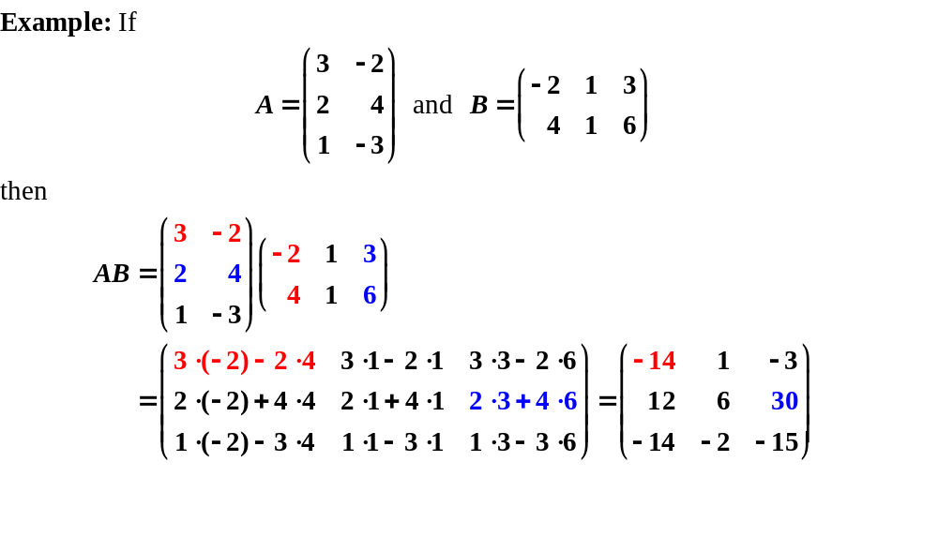
Matrix multiplication

Slide 22
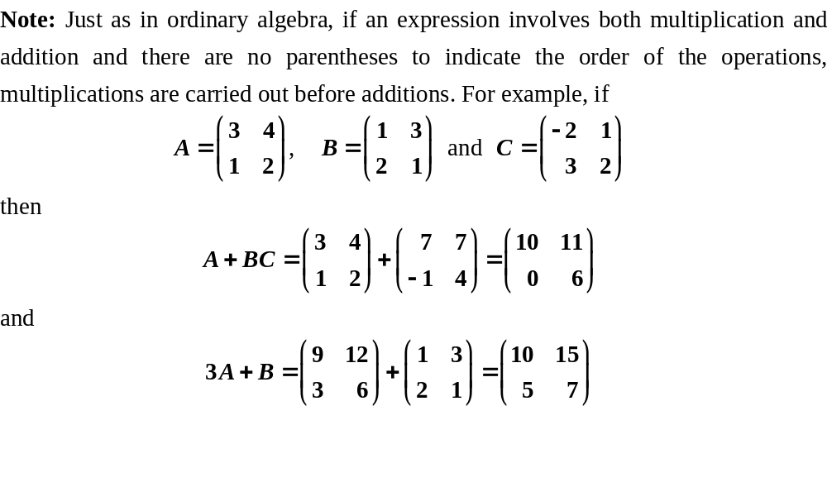
Notational rules

Slide 23
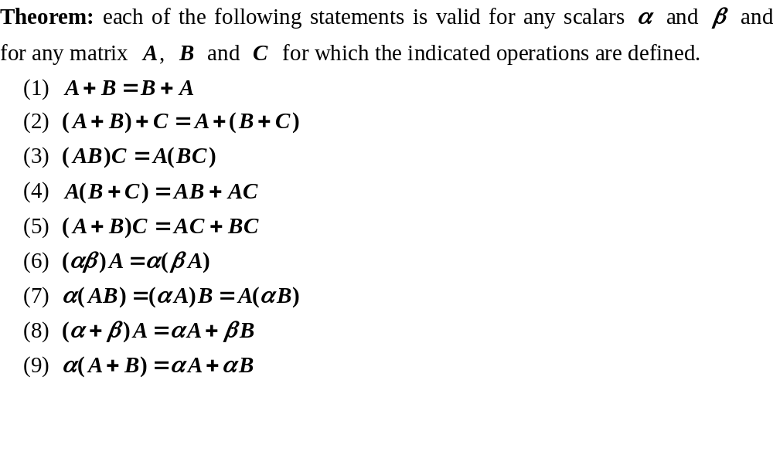
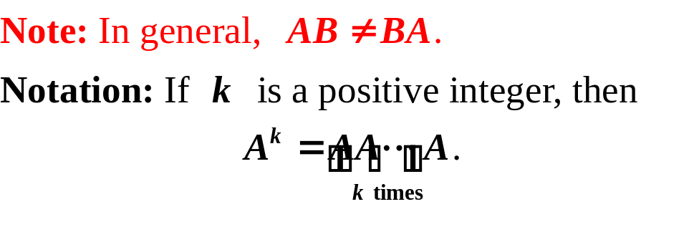
Algebraic rules

Slide 24
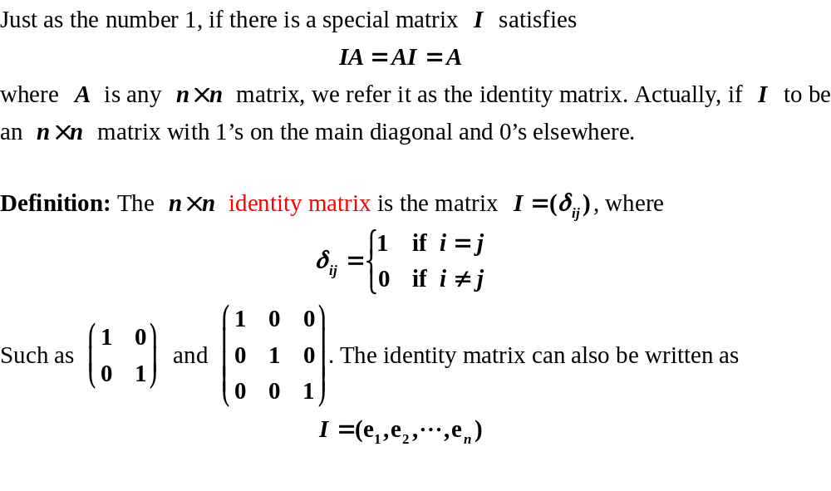
The identity matrix

Slide 25
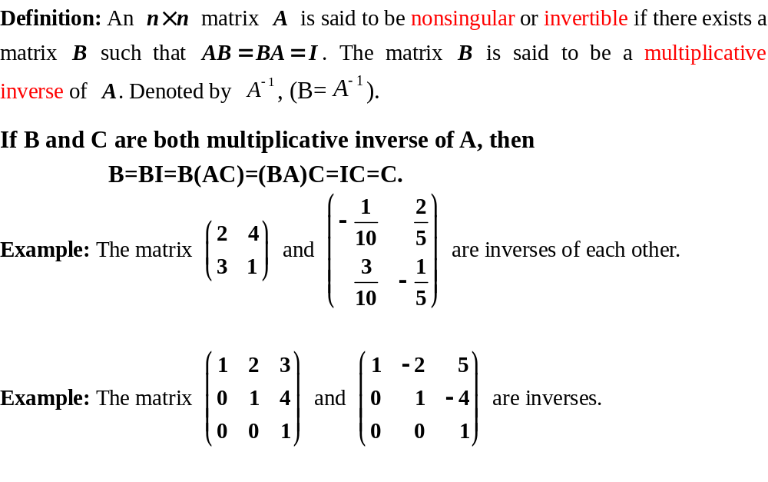
Matrix inversion

Slide 26
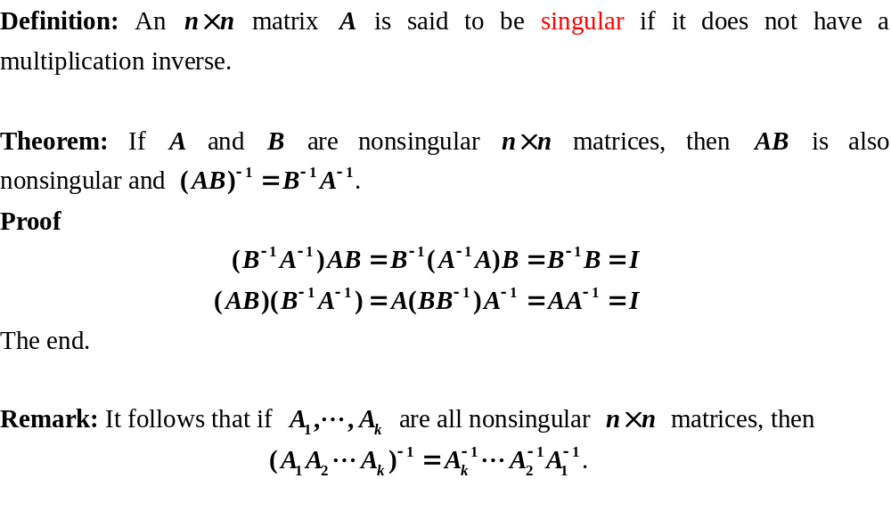
Matrix inversion

Slide 27
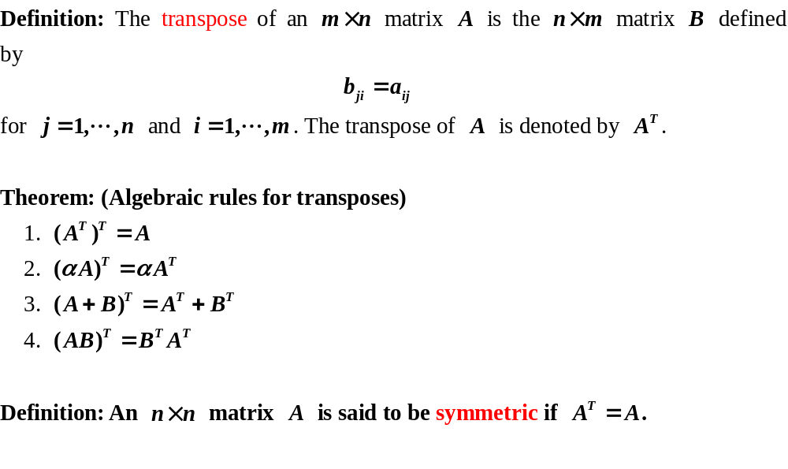
The transpose of a matrix

Slide 28
Review
The notation of matrix
The definition of vectors
The operations of matrix (equality, scalar multiplication, addition, multiplication, inversion and transpose)

Slide 29
Exercises
P62/1(e)(f)(g)(h),2(c),11,22,26
Preview
Elementary matrix
Partitioned matrices

